Slide 1


Assessing University Curricula on Hydrogen Education
2024 - 2025 Senior Design Project
Supervisor: Ashley Roberts, Jeremy Keffer
Team Lead: Isaac Weber
Project Members: Kerry Ferguson, Logan Levine, James Lloyd, Thomas Pelosi, Alexander Peluso, Zachary Pruett

Slide 2
Items for Today
Project Introduction Context, goals, and why structured data matters
Pipeline Overview and Development Process
Complete Data Pipeline: Acquisition, Process, Analysis and Display
Results and Visualizations Web and PDF scraping outcomes — successes and challenges
Final Steps & Takeaways Remaining tasks, handoff readiness, and lessons learned

Slide 3
Overview — The Challenge Presented and its Importance
The energy transition is reshaping the U.S. economy, and hydrogen plays a central role in decarbonization across multiple industries—from power to transport to manufacturing.
Workforce readiness is a critical bottleneck. The hydrogen industry spans across multiple sectors and use cases, but it’s unclear what knowledge and skills align with which specific roles, and current university offerings are fragmented and inconsistent.
Without better visibility into hydrogen-focused coursework, stakeholders risk mismatches between workforce training and real-world needs. This slows deployment, weakens collaboration, and hinders strategic planning across regions.

Slide 4
Project Goals — What are We Trying to Accomplish?
Build a structured dataset of university course offerings relevant to hydrogen.
Use scalable web and PDF scraping to collect course descriptions from priority and non-priority institutions.
Develop a classification system to assess course relevance based on hydrogen-specific keywords and themes.
Provide metrics, visualizations, and confirmation tools to support data quality and facilitate stakeholder decision-making.
Provide clear documentation to ensure future usability by non-programmers and policy-focused users.

Slide 5
Importance of Structured Data for Analysis
Why bother with structured output? Counting keywords would be much easier.
Raw keyword counts are noisy and often misleading
A single page might match a keyword many times without actually describing a course
Why structure by course?
Ensures one-to-one mapping between content and educational offerings
Enables consistent comparison across institutions, regardless of catalog format or verbosity
What structured data unlocks:
Aggregation by department, course level, or degree type
Confirmation workflows and duplicate detection

Slide 6
Data Pipeline & Development Process

Slide 7
High Level Overview
Data Sources
University course catalogs (websites and PDFs)
Broad range of formats and structures across schools
Extraction
Custom scraping tools built for both HTML and PDF sources
Handled JavaScript-heavy sites and unstructured PDF data
Adapted to site-specific challenges with config-driven scrapers
Transformation
Standardized course data across schools
Applied keyword scoring algorithms to quantify hydrogen relevance
Generated derived fields and confirmed data integrity
Analysis & Visualization
Identified patterns in hydrogen-related curricula
Built keyword heatmaps, group occurrence charts, and relevance metrics

Slide 8
Comparing Scraping Methods
Web Scraping
Pros:
Real-time data
More automation-ready
Cons:
Breaks with site changes
Anti-scraping measures
PDF Scraping
Pros:
Common format
Works offline
Cons:
Highly inconsistent formatting
Hard to create generalized scraping tool

Slide 9
Web Scraping Iterations
Naive Scraper
No modularization
Each school requiring complete scraping logic
High amount of repeated code
Spider Base Class
New schools created as extension of base class
Some reuse of basic operations
Some repeated code for scrapers
Scraper Module
Complete abstraction from scraping framework
No code needed for new scraper
Instead pass in HTML selectors

Slide 10
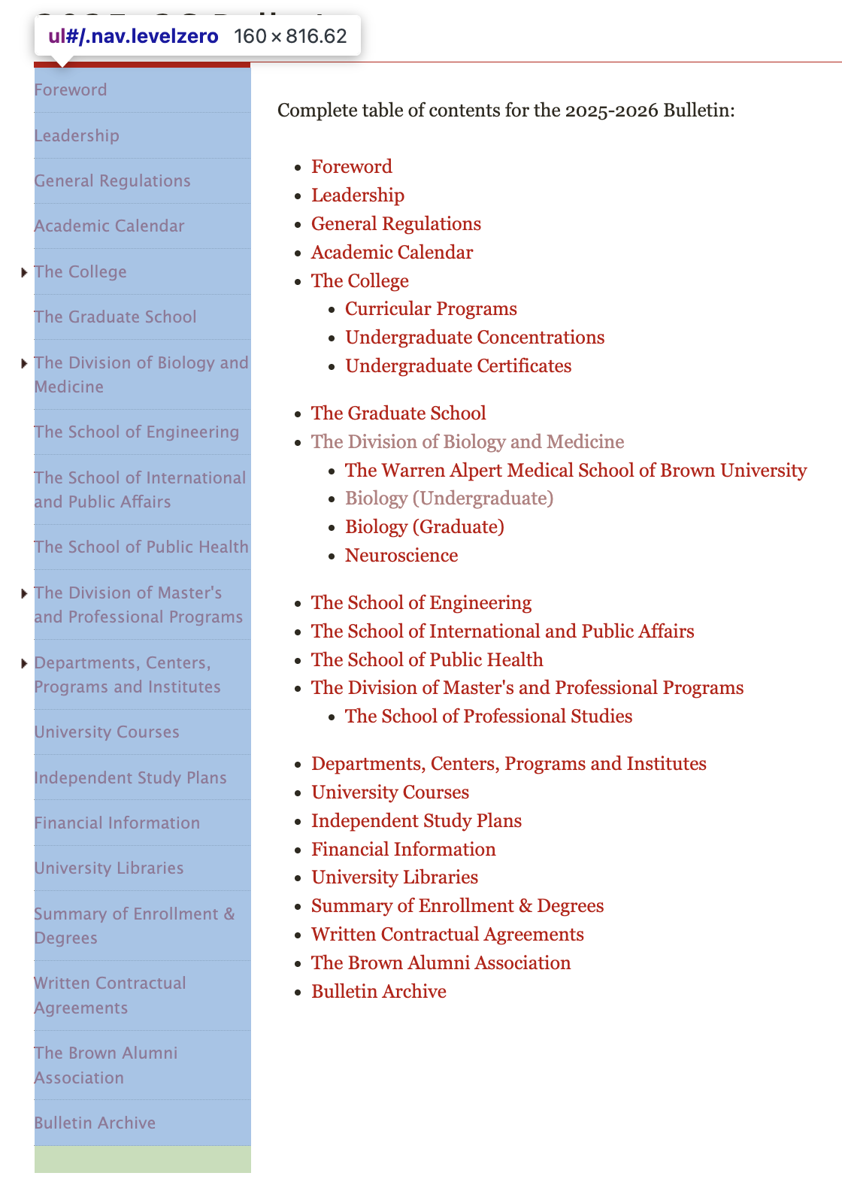
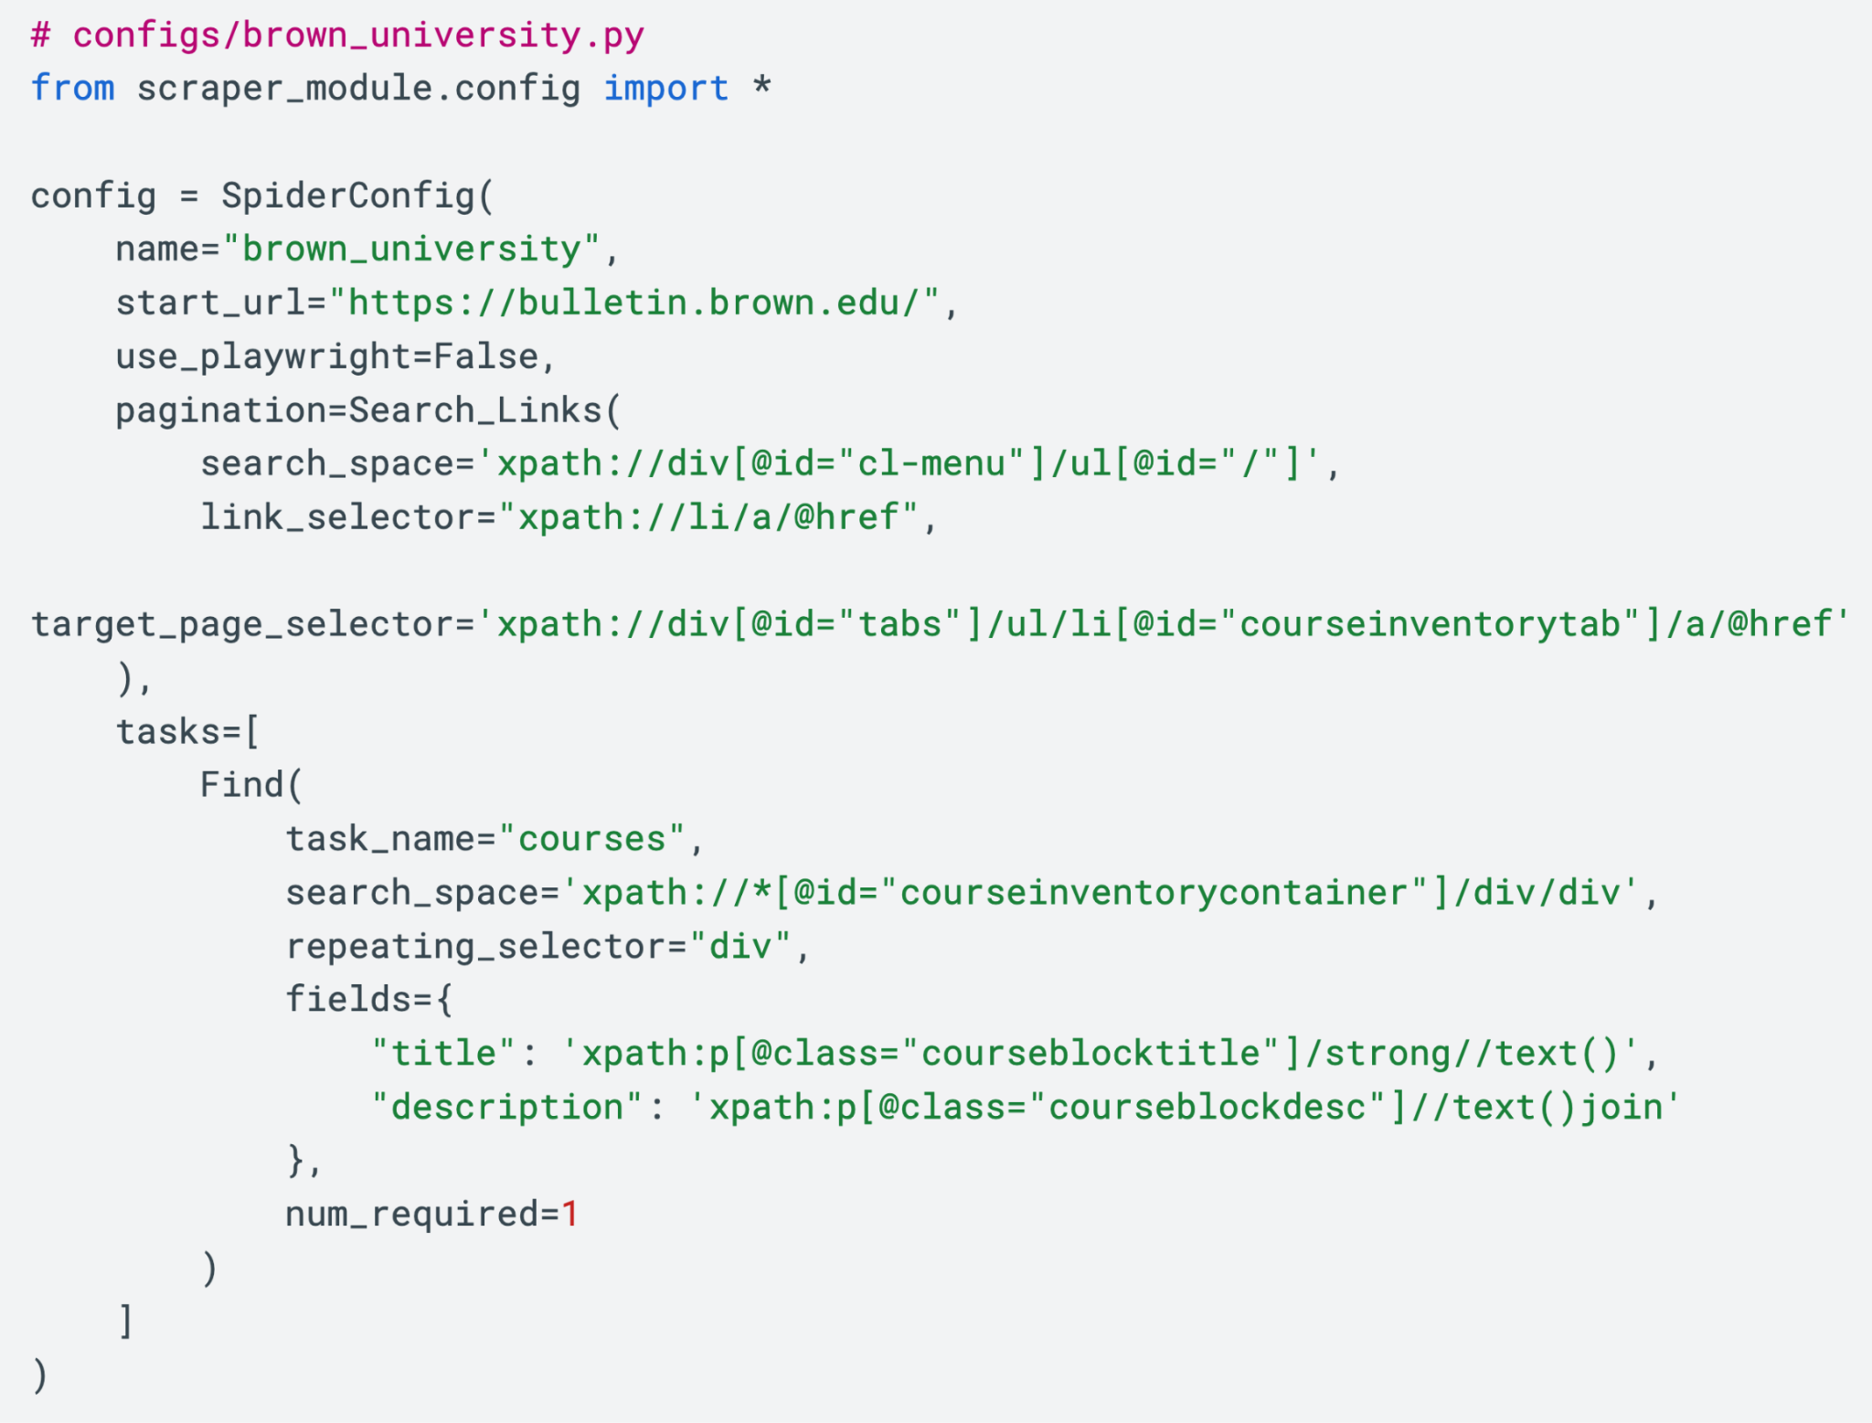
Scraper Module Labeled Example — Pagination
Start URL to search on
Limit where searching for links

Slide 11
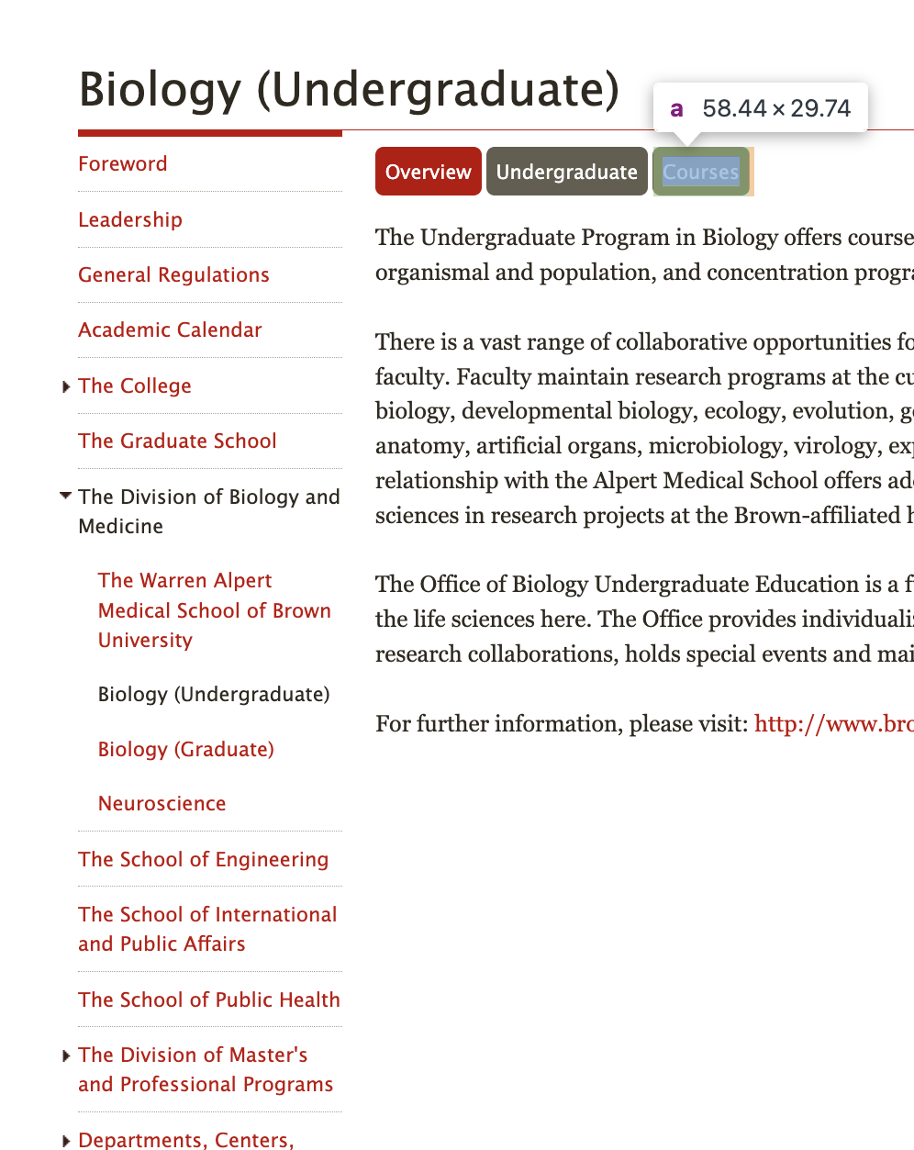
Scraper Module Labeled Example — Pagination
Select next page to search
Identify when target page has been found

Slide 12

Scraper Module Labeled Example — Extraction
Executed on each target page found by pagination
Define new search space for courses

Slide 13
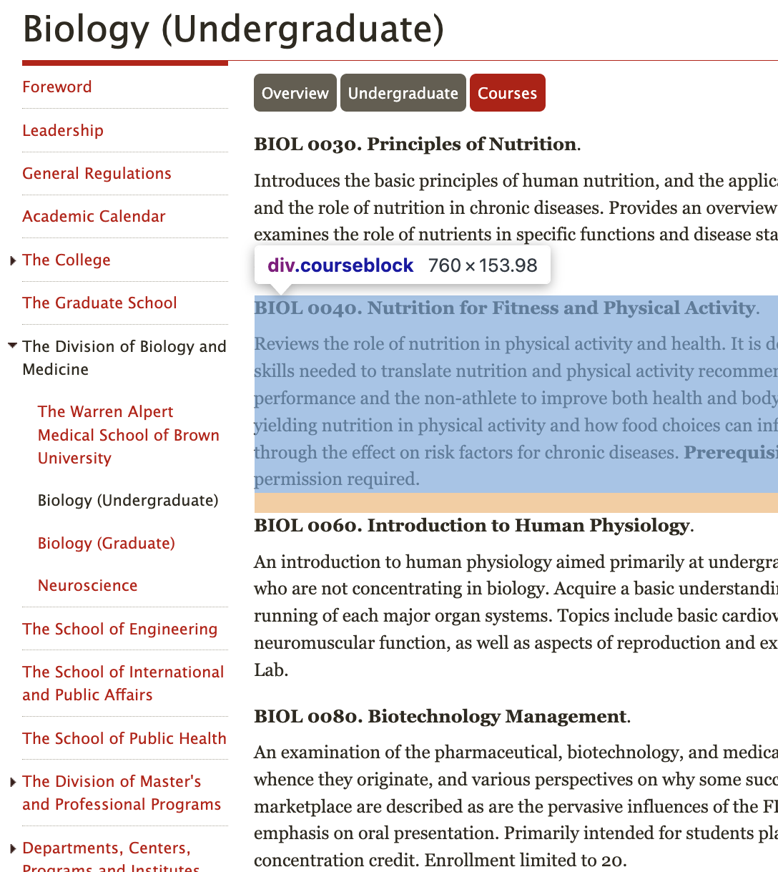
Scraper Module Labeled Example — Extraction
Iterates through each course using the repeating HTML tag
Extract title and course description for each course

Slide 14
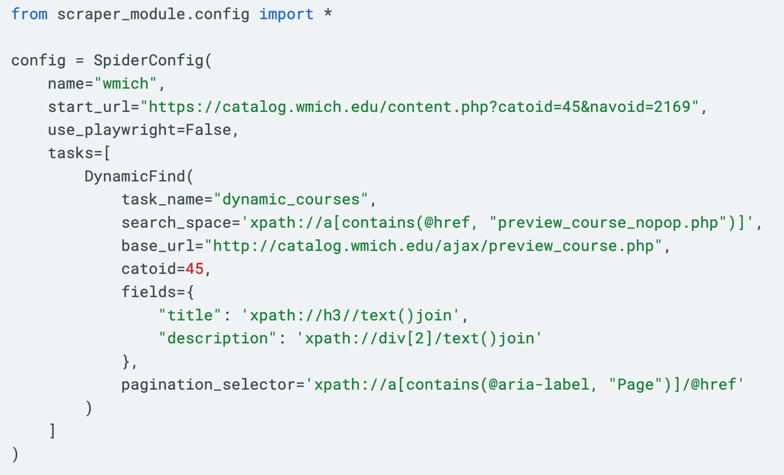
Scraper Module Labeled Example — Using Catoid
URL including the catoid
catoid also passed into config

Slide 15
Scraper Module Labeled Example — Using Catoid
Everything else stays the same!

Slide 16
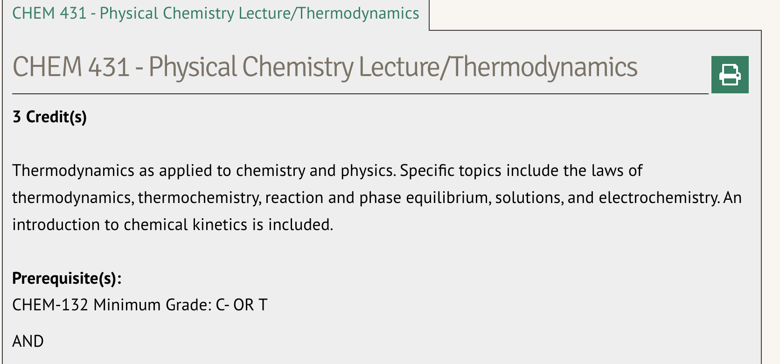
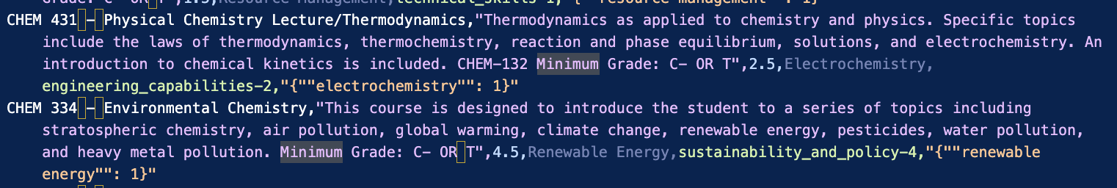
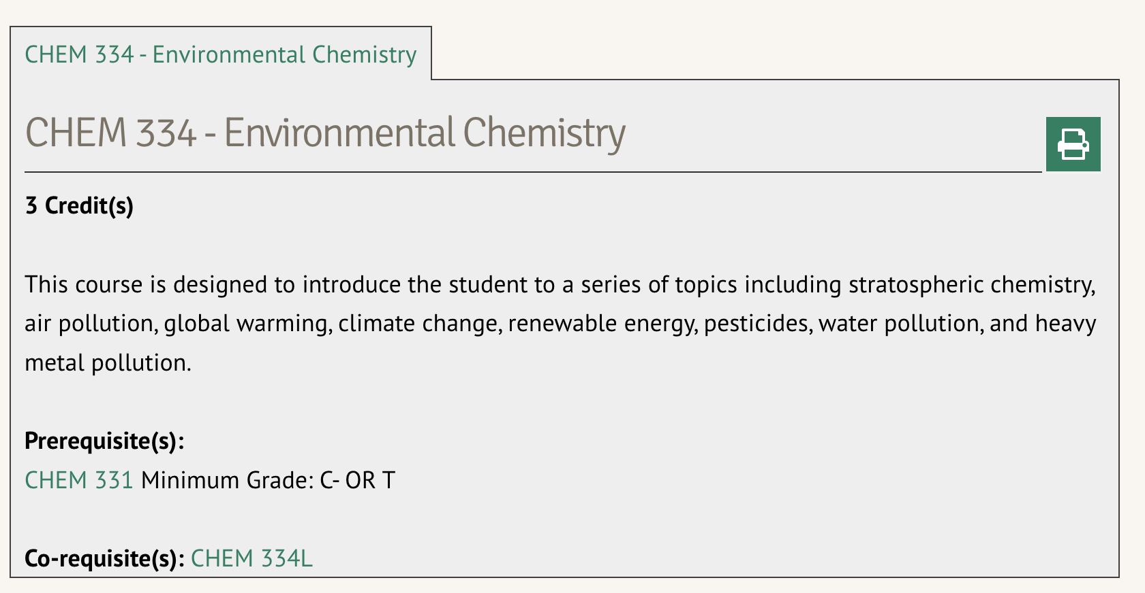
Web Scraping Success — Adams State University
Website Input:
Scraper Report Output:

Slide 17

Web Scraping Issues — Duke University
General Issues Encountered:
Websites blocking access to our scrapers because of the large amount of requests being given to the server
Our scrapers cannot access schools using CourseDog website builders
Poorly optimized websites need manual creation for our scraper
Duke Example:
The issue with Duke University is that its site uses a system called CourseDog
Not able to be scraped from HTML or AJAX, two scraping methods we currently have currently scraping right now.

Slide 18
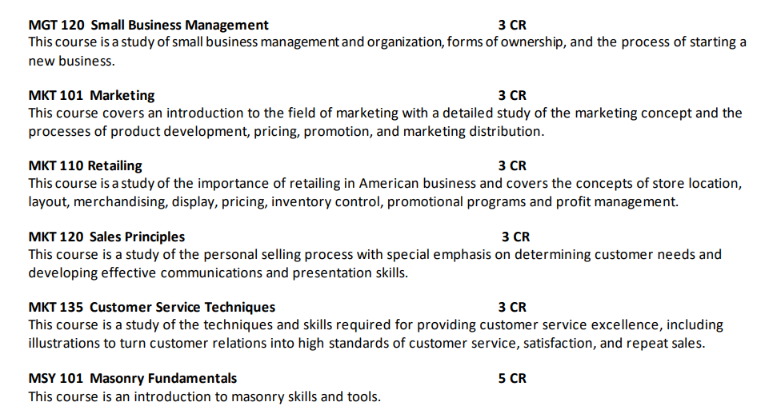
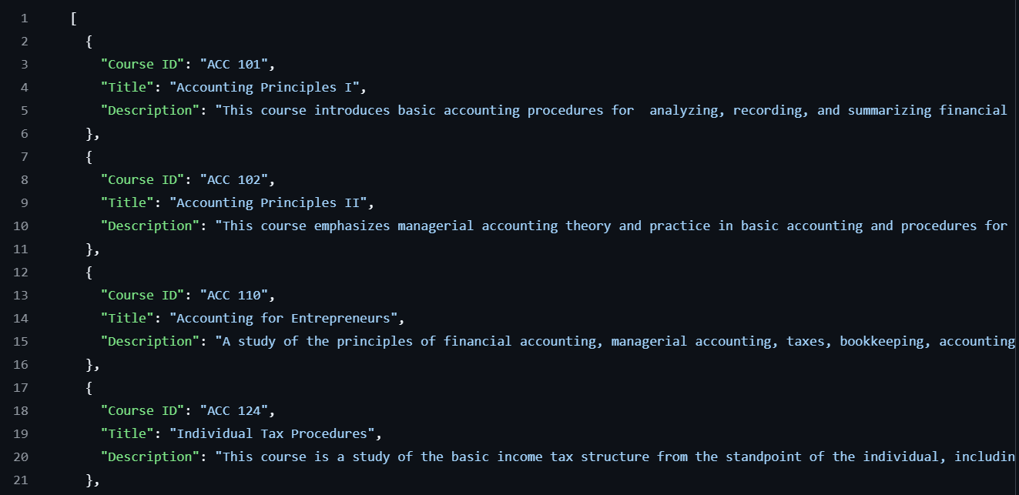
PDF Scraping Success — Denmark Technical College
PDF Input: PDF 211 Page
PDF Scraper Output: JSON Output

Slide 19
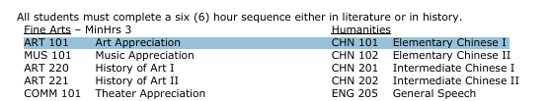
PDF Scraping Issues — Alabama A&M
General Issues Encountered:
Inconsistent formatting in PDFs caused inaccuracy
Different sections of certain PDFs required different parsing methods, making it more difficult to properly scrape an entire document
PDFMiner encountered trouble with poorly formatted PDFs
Alabama A&M example:
Due to the document formatting, PDFMiner reads these two courses as only one line, instead of two separate course listings.

Slide 20

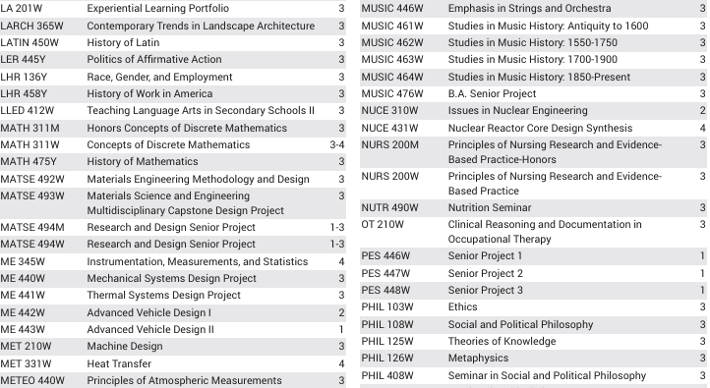
PDF Scraping Issues - Pennsylvania State University
Penn State Course Catalog PDF

Slide 21
Metrics for Evaluation — Terms and Definitions
Evaluated: First step in pipeline, assess whether a given school is scrapable
Scraped: Scraper configuration created for the school
Includes both Web and PDF based scrapers
Confirmed: Final processed results are compared using two independent scraping method (different scraper tool, pdf catalog, manual checking)
Not all scrapers need to be confirmed, this is meant to be a metric to evaluate overall quality
Final Review: Final step in process, final set of Hydrogen related courses reviewed by industry expert to verify the quality of the dataset

Slide 22
Building Confidence In Results
.pdf
pdfminer
Processed Course Data
Confirmation Pipeline
website
Naive Scraper
Results Comparison
Main Pipeline
Processed Course Data
Main Scraper

Slide 23
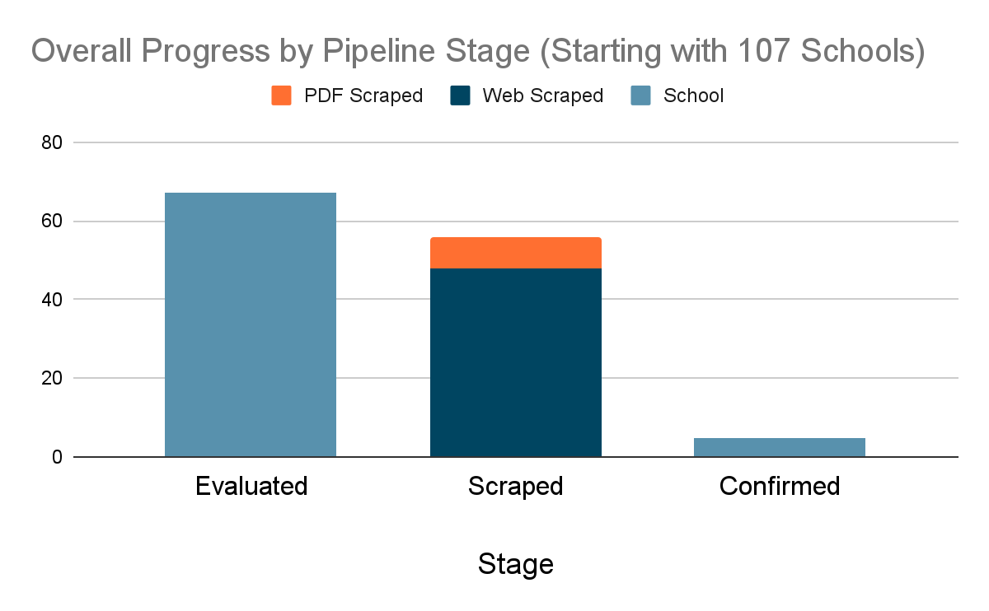
Overall Progress Made
107 total schools
67 evaluated (63% of total)
49 scraped (73% of evaluated 46% of total)
1 confirmed (2% of total)
PDF scraping and confirmation stages had the slowest progress due to inconsistent formatting, scraper limitations, and manual review needs

Slide 24
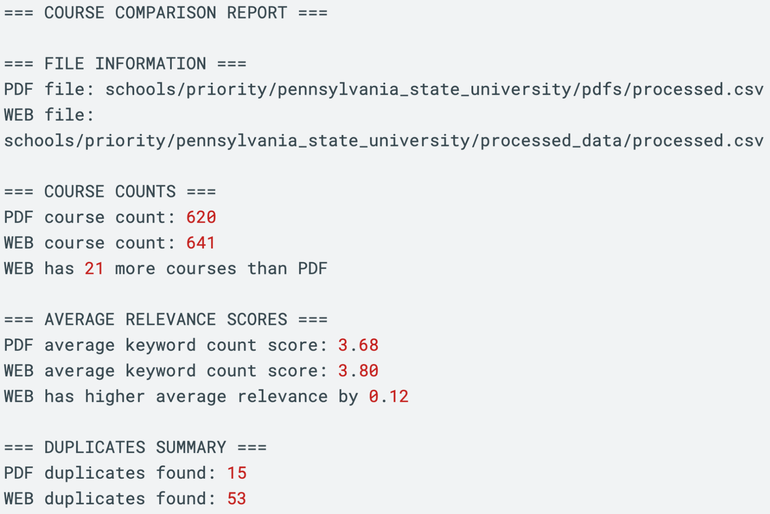
Confirmation Report — Penn State
The only school we were able to obtain a high enough quality PDF course dataset to perform useful a comparison with was Penn State University.
Able to compare:
Course counts
Average Keyword Scrorings
Derived from matched keywords
Duplicate courses

Slide 25
Visualizing Results

Slide 26
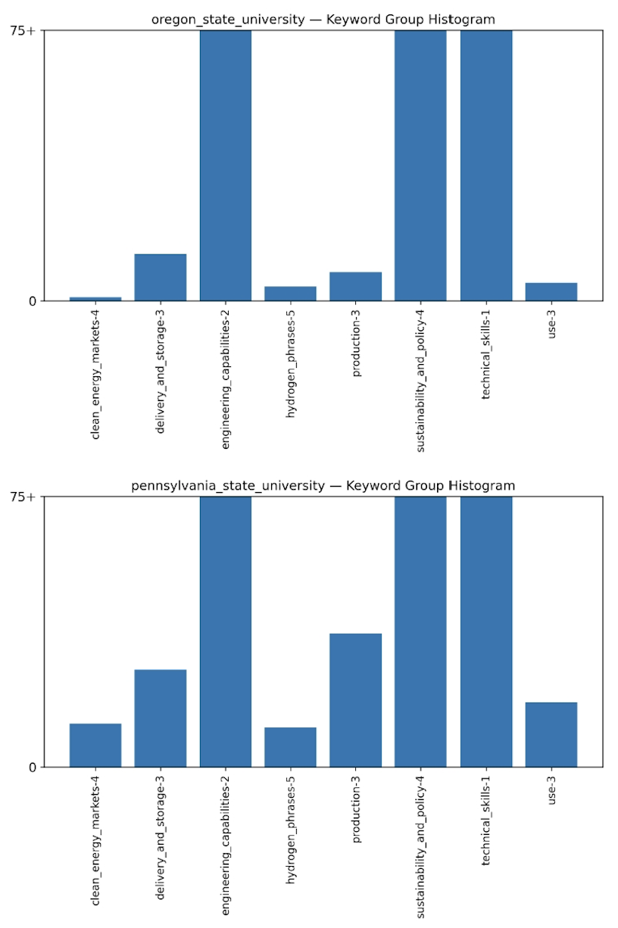
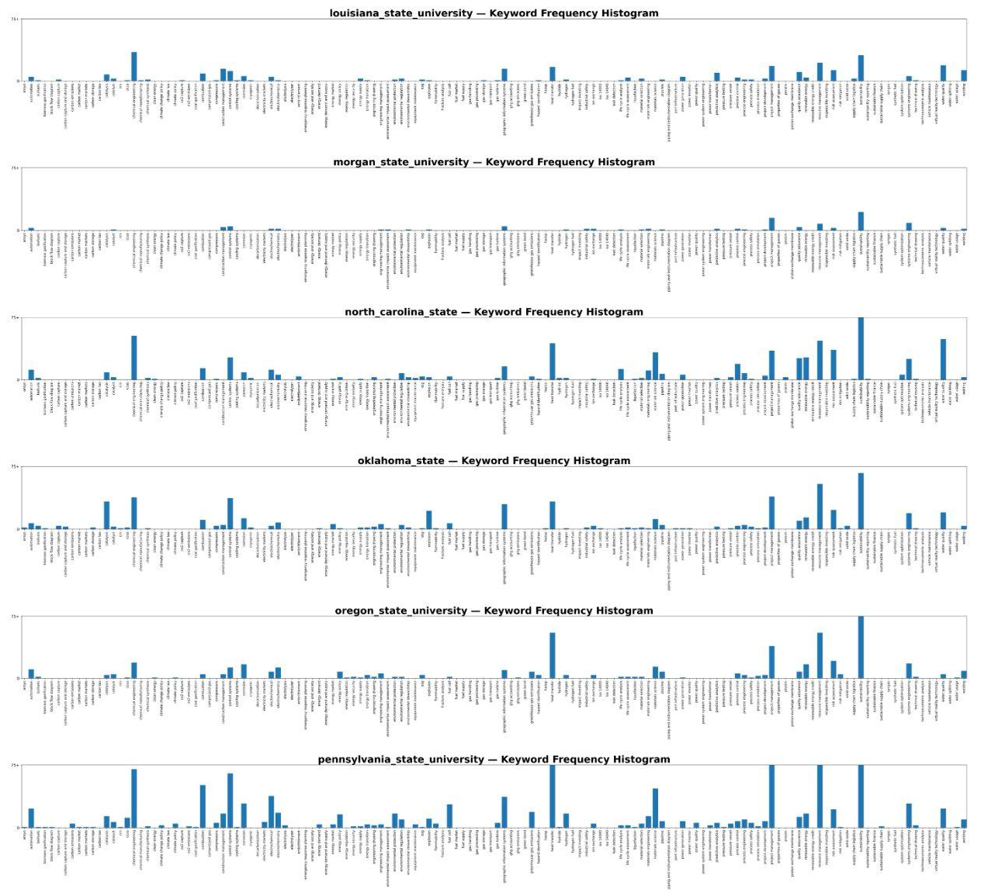
Displaying Results Per School
Keyword Frequencies Per School Histograms: Different levels of granularity provided depending on client needs.

Slide 27
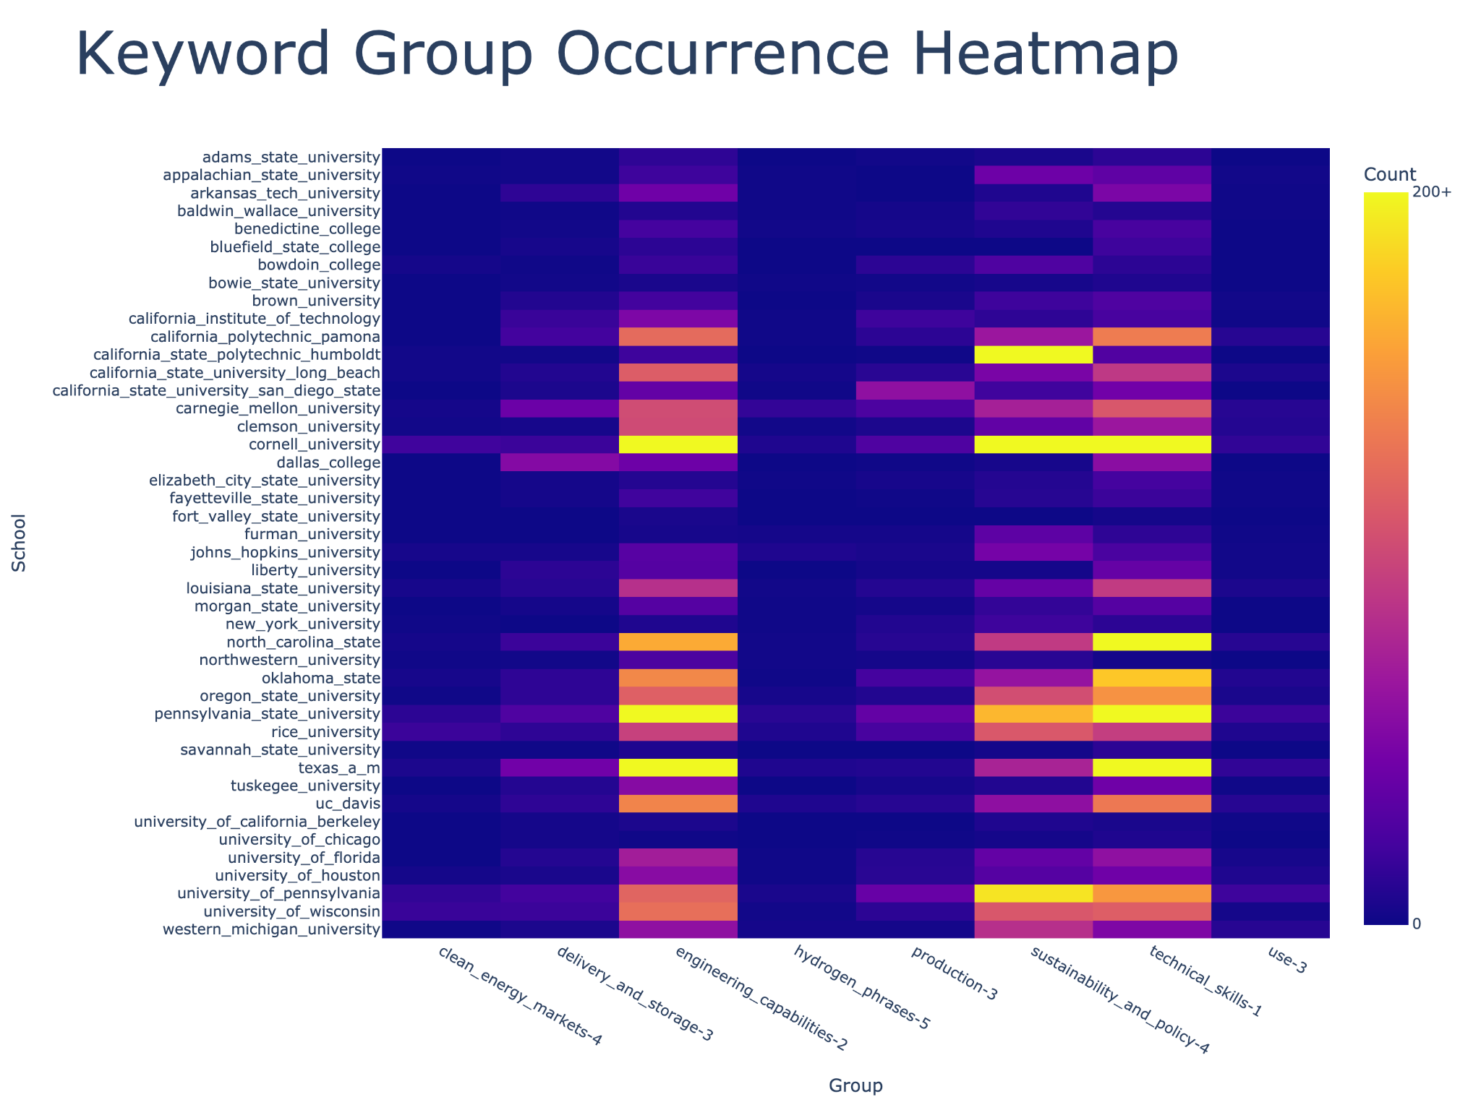
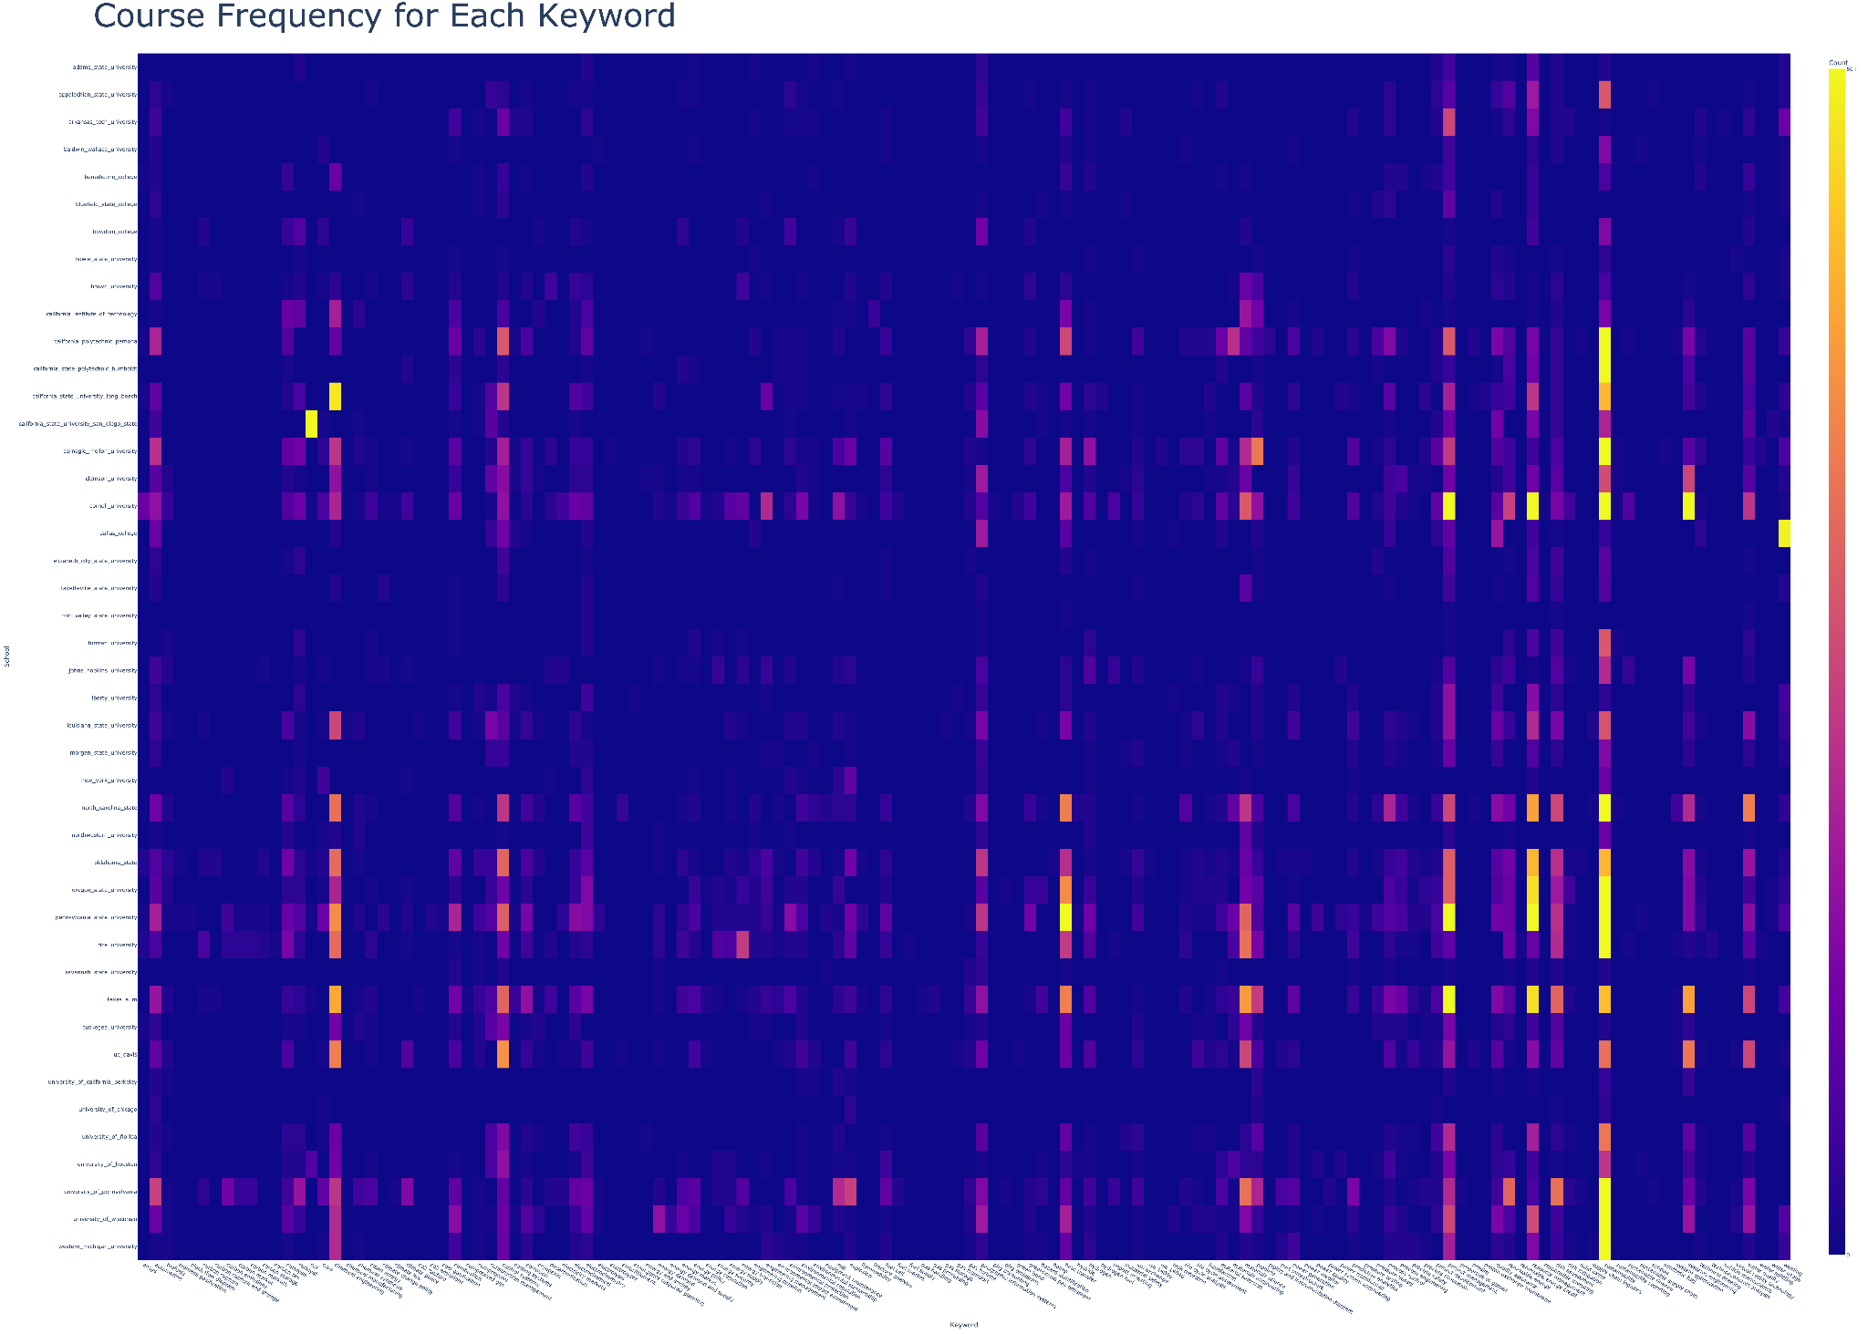
Displaying Results Across Schools
Keyword Frequencies Across Schools Heatmaps: Different levels of granularity provided depending on client needs.

Slide 28
Live Demo
Repository can be found here

Slide 29
What’s Next?
Building a User-Facing Website
Improve usability and accessibility for non-technical users. The existing modular structure and automation scripts provide a solid foundation for integration.
Enhance data storage, querying, and scalability beyond file-based processing.
Improving Course Classification
The current keyword scoring system is prone to false positives/negatives, especially when course language is inconsistent.
Consider machine learning or NLP techniques for more reliable classification.
Expanding the Dataset
Include additional schools, training programs, and external sources such as job postings.
Enables richer, cross-sector analysis of workforce needs in the hydrogen economy.

Slide 30
Thank You! Any Questions?

